Slide 1
Demonstration of Passive Flow Control with Vortex Generators
MD MANSOOR ALAM-24BME0562
MASHKUR INAB-24BMV0068
SRIDHAR HARISH-24BMV0073

Slide 2
AIM OF THE PROJECT -
To design, build and demonstrate a passive boundary-layer control system using small vortex generators on paper wings that-
delays flow separation
improves lift
reduces drag
quantify the aerodynamic effects through visualization and force measurements.

Slide 3
OBJECTIVE OF PROJECT-
Design vortex generators suited for small-scale paper wing models (define shape, size, angle and placement) and fabricate them reproducibly.
Demonstrate flow modification by visualizing boundary-layer behavior (tufts/smoke/dye) on a baseline wing and on the wing with VGs.
Measure performance changes by recording lift and drag over a range of angles of attack (AoA) for baseline vs. VG-equipped wings.
Report results with photos/plots, error estimates, and recommendations for optimal VG geometry/placement.

Slide 4
PRINCIPLES OF THE PROJECT-
1. FLOW SEPARATION-
Flow separation happens when the smooth airflow moving over a surface (boundary layer) like a wing losses energy and can no longer stay attached to that surface.
SIGNIFICANCE-
When separation occurs, lift drops sharply (because smooth airflow is disrupted).
Drag increases dramatically (due to large wake and pressure drag).
The wing can stall meaning it can’t produce enough lift to support itself.

Slide 5
2. LIFT –
Lift is the upward aerodynamic force that acts perpendicular to the relative airflow over a wing.
It is generated due to pressure difference between upper and lower surface pressure difference.
Air travels faster over the curved top – hence low pressure, whereas it travels slower under the wing – hence high pressure.
This pressure difference pushes the wing upward.
EFFECTS OF FLOW SEPERATION –
As angle of attack increases, lift increases till the stall angle.
When it passes the stall angle the flow separates, and lift drops rapidly.

Slide 6
3. DRAG-
Drag is the aerodynamic force opposing motion, acting parallel to the airflow.
a. Skin friction drag –
Due to viscosity and friction on the wing surface (from boundary layer).
b. Pressure drag-
Due to separated flow creating a low pressure wake behind the wing.
EFFECT OF FLOW SEPERATION –
The wake behind the wing grows larger.
Pressure drag increases sharply.
Total drag becomes much higher.

Slide 7
Important terms-
Vortex Generators - A vortex generator is a small, fin-like aerodynamic device placed on the surface of a wing (or any body in airflow) that creates controlled swirling motion (vortices) in the airflow.
Angle of attack (AoA) – The angle between the chord line of the wing and the direction of the oncoming airflow (relative wind).
Stall – A stall occurs when the AoA (Angle of attack) of a wing increases beyond a critical value such that the smooth airflow separates from the upper surface of the wing, causing a sudden loss of lift and a sharp increase in drag.
Wake – The wake is the region of disturbed, turbulent, low energy airflow that forms behind an object as air flows around it.

Slide 8
Materials required -
Cardboard
Stand
Ruler and protractor
Thread
Hard paper
Source of wind (hair dryer, fan)
Mobile camera (to understand the behavior of the wings).

Slide 9
Construction of the model-
Initially, make the surface using cardboard to be mounted on the stand which will be the base for the wings to be positioned at different angles.
Make sure that it is positioned geometrically with the stand.
Now make two wings (for left and right corner) to be attached with the base.
Install threads at the ends of both the wings which will show the movement to determine the properties such as drag, lift and flow separation.
In one of the wing (either right or left), install small vortex generators drawn out of hard sheet of paper.
Attach the VGs in front of the thread and firmly tighten them.
Mount the base attached with the wings on the stand and fix them firmly.
By the use of ruler and protractor change the AoA(angle of attack) of the wind by bending the wings.

Slide 10
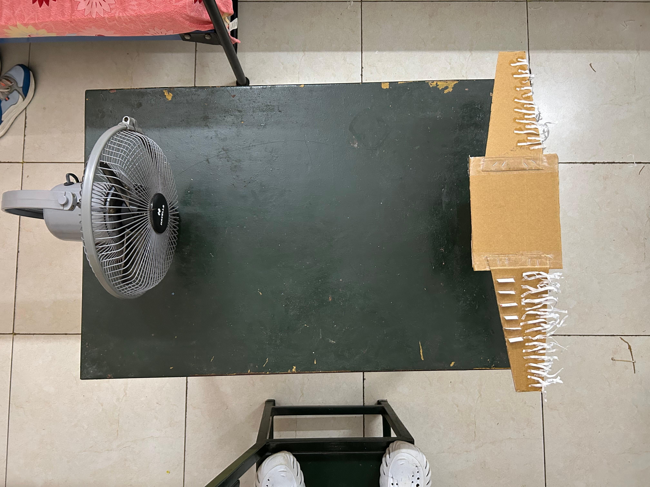
MODEL-

Slide 11
Important Points for Designing Vortex Generators
Determining the shape of the Vortex Generators.
Determining Reynolds Number of Flow.
Determine length of VGs and their location along the chord of your wing.
Determine the height of VGs.

Slide 12
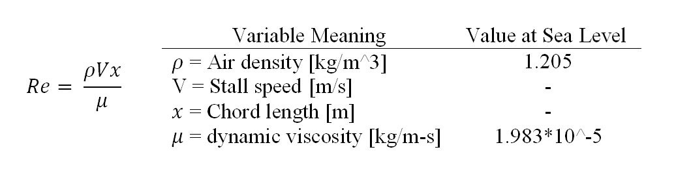
Determining the shape of the Vortex Generators :
Here we took the shape of a rectangle for our VGs
Determining Reynolds Number of Flow :
While designing the VGs we need to determine what Reynolds Number we will be
operating at through this equation.

Slide 13
Determine length of VGs and their location along the chord of your wing.
Next we will need to determine the length of the VGs and where along the chord of
the wing VGs will be placed.
The length of our VGs should be around 5-8% of the chord length of the wing as the
data from different sources suggested for rectangular VGs.
The VGs should be placed just in front of the laminar to turbulent transition of the
boundary layer on the wing.
Determine the height of VGs :
Next you will want to determine the height of your VGs.
VGs work to control the boundary layer and thus they are most effective inside the
boundary layer. On larger general aviation aircraft and airliners, VGs typically have a
height 80% that of the laminar boundary layer right before the laminar to turbulent
transition point on the wing. However in this model it will be much smaller.

Slide 14
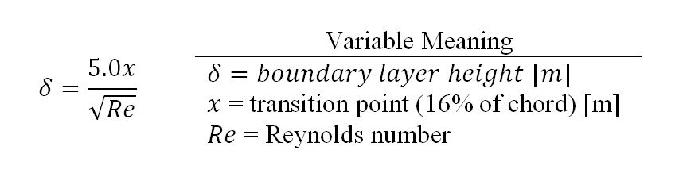


To calculate the height of the laminar boundary layer on the wing before the transition point we can use the following equation below.

Slide 15
OBSERVATIONS-
The introduction of small vortex generators on the wing surface significantly delayed the onset of flow of separation as seen by a smoother airflow and reduced size of the separated flow region near the trailing edge.
The paper wings equipped with vortex generators exhibited increased lift at moderate angles of attack compared to wings without generators, confirming the improvement in lift performance stated in the project aim.
There was a noticeable reduction in drag, particularly post-stall and during higher angles of attack operation, making the wing more efficient aerodynamically.
Visualization methods (movement of threads) clearly showed that high-momentum air was transported towards the wing surface, resulting in a thinner and more stable boundary layer and a decrease in reversed (separated) flow near critical regions.

Slide 16
CONCLUSION-
The experiment successfully demonstrated the effectiveness of passive flow control using vortex generators on paper wings
. By introducing small vortex-generating fins along the wing surface, the airflow over the wing was energized, which delayed boundary layer separation and maintained smoother flow over a larger portion of the surface.
As a result, the wing with vortex generators showed improved lift characteristics, delayed stall, and reduced drag at higher angles of attack when compared to the plain wing.
The formation of controlled vortices helped in transferring high-energy air into the boundary layer, increasing its momentum and allowing it to overcome adverse pressure gradients.
This experiment clearly demonstrates the importance of boundary layer control in aerodynamics and how simple passive devices like vortex generators can significantly enhance the aerodynamic efficiency and stability of a wing.

Slide 17
PROJECT VIDEO LINK:
https://drive.google.com/file/d/1sQ5WG1nPcMwRUgO73fjB9oOtH9dUGSJC/view

